Slide 1
Oracle Database Architecture

Slide 2
What is Oracle ?
Oracle is a relational database management system.
It is a management system which uses the relational data model.
In the relational data model, data is seen by the users in form of tables alone.
Oracle Server:
Is a database management system that provides an open, comprehensive, integrated approach to information management.
Consists of an Oracle Instance and an Oracle database

Slide 3
Oracle in Industry
In today’s world, data is the key for business
Every organization stores its data in multiple databases
One of the most widely used database in industry is Oracle
Oracle can work on various Operating Systems (Windows, Unix, etc.)
The demand for Oracle in today’s world is immense
Many projects across the industry use Oracle as back-end for deploying its various applications.

Slide 4
Database Architecture - Introduction
Three Major Instances:
Database instance
File Structure
Data Structures
Database Instance:
Oracle Database consists of Software Modules & Database Files
Instance –After the complete installation of Oracle, when you start the Oracle database , then you have what is referred to as an“Oracle Database Instance”. It is the actual execution of DBMS software that manages data in the databases tablespace.

Slide 5
Properties Of Database Instance
Created on loading the software from disk to memory
It is an aggregation of processes and memory structures
It is sharable thus allowing multiple users to access the same database

Slide 6
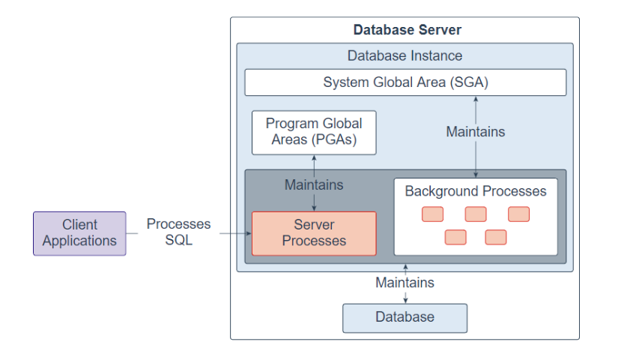
Oracle Instance
Server process
PGA

Slide 7
Memory Components and Background Processes
Two Main Components:
SGA( System Global Area)
a group of shared memory structures that contain data and control information for one Oracle database instance
the data in the instance's SGA is shared among the multiple concurrent users
allocated when you start the database instance
de-allocated when the instance is shutdown
PGA (Program Global Area)
Each server process has a PGA allocated that is a private area for each server
Work area for each application.

Slide 8
SGA Memory Areas
Shared pool contains machine-language code and execution plans for frequently used SQL commands.
Database Buffer Cache stores data values which are written later to the data files by the database writer (DBWn).
Redo Log Buffer stores a copy of the changed data from user transaction. This data is periodically written to the Redo Log Files by the Log Writer (LGWR).
Large Pool is a work area given for backup and recovery operations.
Java Pool stores the machine-language and execution plans for Java commands used in application programs and database operations

Slide 9
PGA Memory Areas
Each server process has a PGA allocated that is a private area for each server
This is the work area for each application
The application code, along with copies of the data, is located here
There are various background processes that support and monitor the server processes. These background processes also handle the data management and keep the database running smooth and efficiently

Slide 10
Processes
System Monitor (SMON) :
-general server housekeeping functions
Process Monitor (PMON) :
- monitors and manages individual user sessions
-performs database locking/unlocking functions on UPDATE and DELETE query.
Database Writer (DBWn) :
-writes changed data from the database buffer cache to data files
-an oracle 10G instance can have 10 writer instances DBW0-DBW9.
Log Writer (LGWR) :
-writes the redo log data from the Redo Log Buffer to the Redo Log Files.
-Redo Log files aid in database recovery.
-keep track of the database changes whenever they are committed

Slide 11
Processes
Checkpoint (CKPT) :
-responsible for signaling DBWn and LGWR to write the contents of the Database Buffer Cache and the Redo Log Cache to the data files and Redo Log files respectively.
Archiver (ARCn) :
-reads the Redo Log files after they are filled & copies it to a corresponding Archive Log File.
-there can be up to 10 separate archive processes per instance Arc0-Arc9.
Recoverer (RECO) :
-detect and correct errors as a result of communications problems in a distributed database environment.

Slide 12
File Structure- Three Basic Oracle Files
Parameter File
1
Control Files
identifies
identifies
Data Files
Provides changes to
Redo Log Files
2
3

Slide 13
Parameter File – the init.ora file
Purpose:
- specifies the configuration information about the database instance.
The parameters include:
Names and locations of the control files
Block size
Cache sizes
Database name
Instance name
Domain name
Is read each time a database instance is started
Has a .ora suffix

Slide 14
Control Files
Purpose:
- contain a list of all other files that make up the database such as data files and Redo Log files.
-also contain important information about the contents and operating state of the database.
The data includes:-
By default, an Oracle 10g database creates three control files,CONTROL01.CTL, CONTROL02.CTL and CONTROL03.CTL and they are mirror images of each other.
The name of the database
Date the database was created
Current state of the database: read-only, need-recovery
Database status when last closed
Interval covered by each archived redo log
Backups performed
Since this is a critical file you should have more than one control file and they should be on separate disk drives
Have a .ctl suffix

Slide 15
Data Files
Purpose:
-contain the actual data stored in the database.
-contains user data stored in tables + includes indexes, data dictionary, and rollback segments.
Characteristics:
Data files are composed of Oracle blocks, which are in turn composed of operating system blocks
Oracle block sizes range from 2 Kb to 32 Kb – average size is 8 Kb
Data files belong to only one database and to only one tablespace within that database
Data files are the lowest level of granularity between an Oracle database and the operating system
When you map out a database onto the OS I/O sub-systems, the smallest unit you can put in any location is a data file
Have a .dbf suffix

Slide 16
Redo Log Files
Purpose:
- store changes made to the database as a result of transaction and internal Oracle activities.
Characteristics:
By default, an Oracle 10g database contains three redo log groups, REDO01.log, REDO02.log and REDO03.log
Every Oracle 10g database must have at least two redo log groups
The database will write log entries to a subsequent redo log group when the previous redo log group fills up
As a general rule , there should be one redo log group for approximately every four database users that create action queries
Oracle 10g keeps track of the Redo Log file by using a redo log sequence number, this number is recorded inside the file as they are used
The redo log sequence number is different than the operating system file name that is used to identify the physical file
If the database is in ARCHIVELOG mode full Redo Log files are copied to Archive Log files before they are reused, otherwise they are written over
Have a .log suffix

Slide 17
Data Structures
Database
Instance
Tablespaces
Tablespaces
Segments
Extents
Data Blocks
Extents
Data Blocks
Data Blocks
Extents
Extents
Data Blocks
Data Blocks

Slide 18
TABLESPACE and SEGMENT
Tablespace is used to store related database objects. One tablespace is used to store all of the system tables; another tablespace may be created for all indexes or a tablespace may be created to store all of the tables for a specific application. The idea is to store data that has something in common or has similar characteristics. The database server stores the data in each tablespace in data files with .dbf extensions.
Segments are used to organize tablespace data within a tablespace. A segment stores an individual database object like a table or index.

Slide 19
EXTENTS and DATA BLOCKS
Extents are contiguous units of storage, usually disk space, within a segment. Oracle uses extents for performance reasons by storing data that needs to be retrieved in a single disk I/O. An extent is made up of multiple data blocks
Data Blocks are the smallest unit of Oracle database storage. Oracle 10g stores 8,192 bytes (8K) in one data block. A data block is comprised of multiple operating system blocks. Depending on the operating system an operating system block can store 512 to 4K bytes. A data block contains header, directory and row data:
Block Header - operating system block address
Table Directory - identifies the database table for which the following data belongs
Row Directory - identifies the database rows for which the data belongs
Row Data - stores the actual row values

